Slide 1

Experiment Text Sentiment Classification
Acknowledge to: Guoqiang Zhong
Organizers: Guoqiang Zhong, Zhaoyang Niu
Machine Learning Research Group
Ocean University of China
Qingdao, China

Slide 2
Text Sentiment Dataset
Stanford’s Large Movie Review Dataset
http://ai.stanford.edu/~amaas/data/sentiment/aclImdb_v1.tar.gz
This dataset contains movie reviews along with their associated binary sentiment polarity labels. It is intended to serve as a benchmark for sentiment classification.
The core dataset contains 50,000 reviews split evenly into 25k train and 25k test sets. The overall distribution of labels is balanced (25k pos and 25k neg). We also include an additional 50,000 unlabeled documents for unsupervised learning.

Slide 3
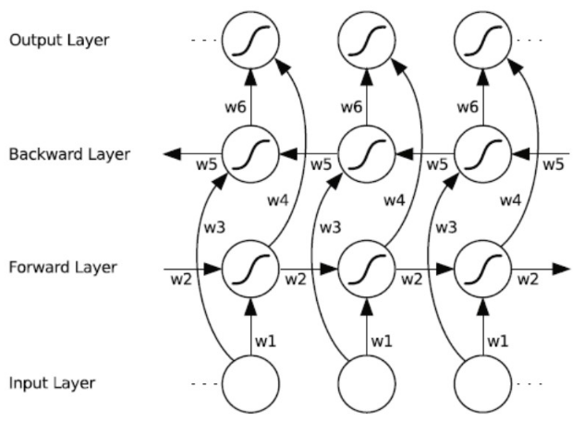
BiRNN

Slide 4
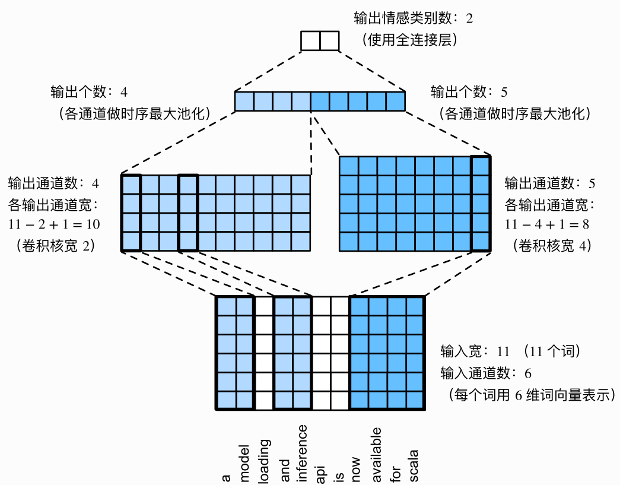
TextCNN

Slide 5
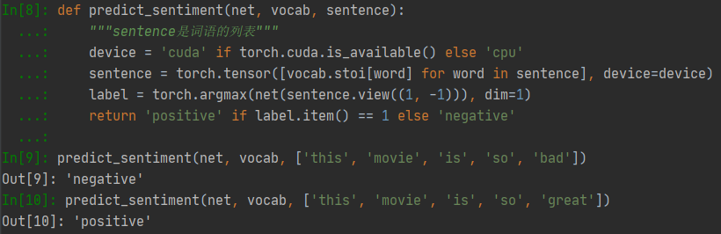
Result

Slide 6

Experiment
Use the dataset for the experiment of sentiment classification.
Write the Python code of a RNN or CNN to solve the sentiment classification problem, and predict some examples.
Submit your compressed code, result and report in two week to DL2021Spring@163.com. The code should be reproducible, the result includes the classification accuracies obtained by RNN or CNN on the test set, while the report introduces the detailed process of your experiments.

Slide 7
Thank you!

